Slide 1
Optimal Ordering Plans for Personal Protective Equipment during the COVID-19 Pandemic
Chelsea Greene, Doctoral Student
Dr. Zelda B. Zabinsky, Advisor
Industrial & Systems Engineering
University of Washington
An inventory management optimization model
August 2020 Update

Slide 2
About the Inventory Optimization Model
Model Objective
Provide optimal ordering decisions for minimizing the risk of unsatisfied demand through maximizing fulfilled demand at a given time adjusted to the value of when the demand is fulfilled, weighted for item critically, and item quality
Model Considerations
The model is set up to handle dynamic and stochastic demand and supplier capacities that are inherent to a pandemic situation
Budget and warehouse capacity
Model Primary Decision Variables
When and how much of each PPE item should be reordered
Sensitivity Analysis
Trade-offs between budget and the amount of fulfilled demand
Impacts of uncertainties in supplier capacities and demand

Slide 3
Model Inputs

Slide 4
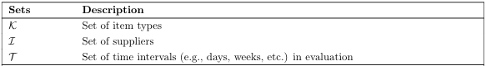
Sets
We define 3 sets
Set of item types (e.g., masks)
Set of suppliers
Set of time intervals (e.g., days, weeks, etc.) in evaluation

Slide 5
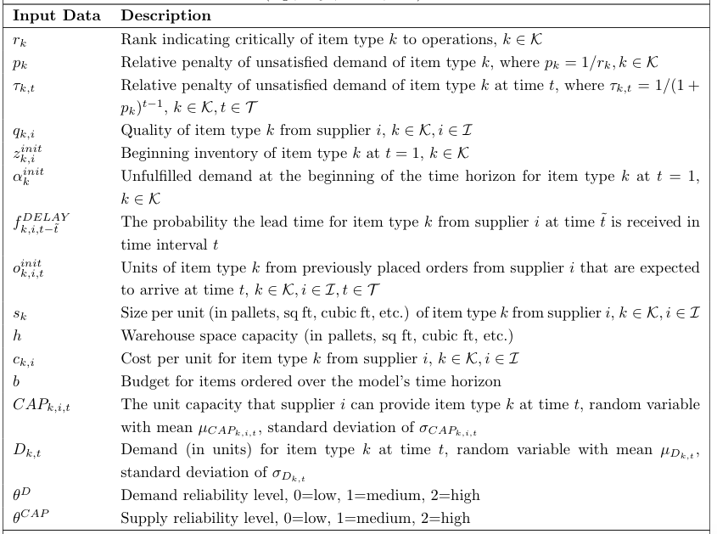
Input Data

Slide 6
Experimental Design

Slide 7
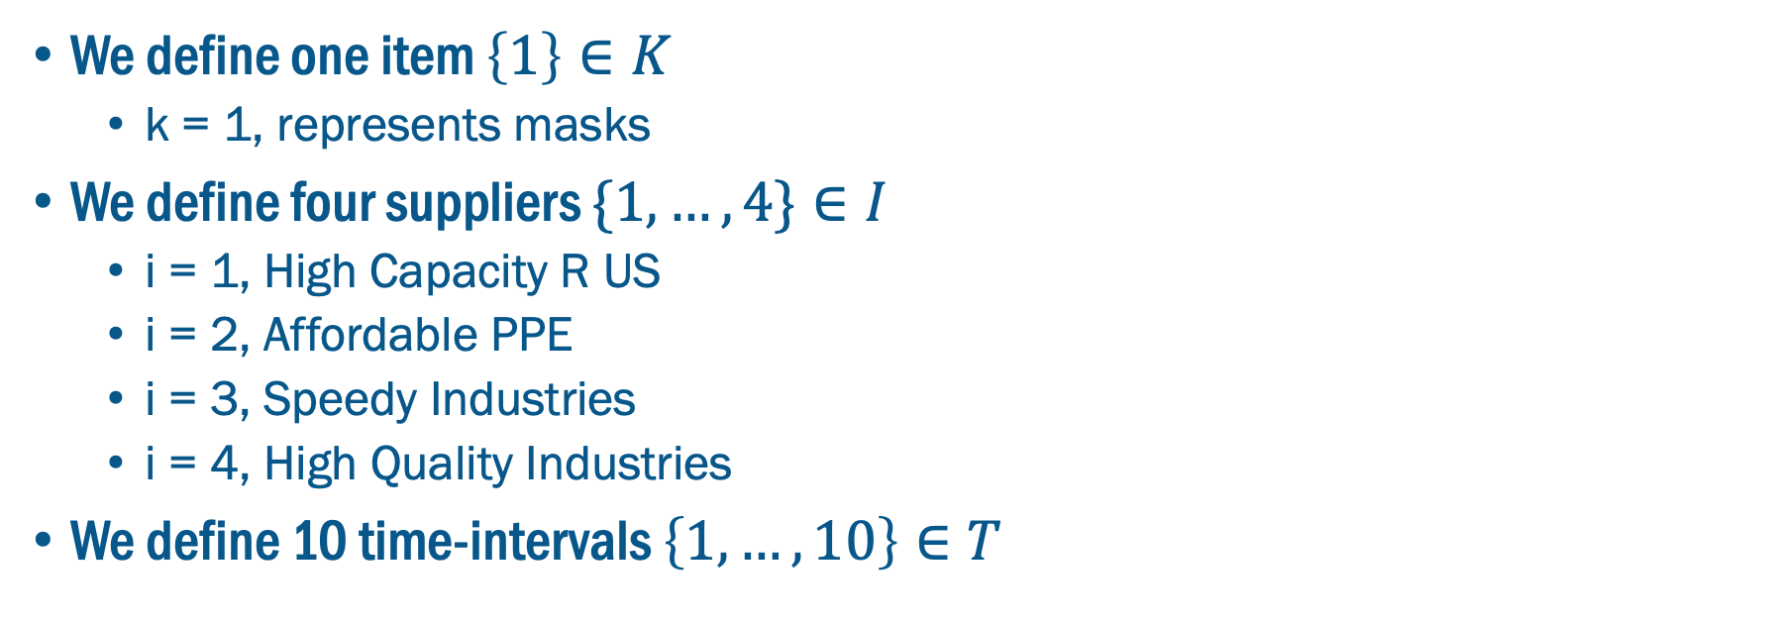
Sets
We define one item $\left\{1\right\}∈K$
k = 1, represents masks
We define four suppliers $\{1, …,4\}∈I$
i = 1, High Capacity R US
i = 2, Affordable PPE
i = 3, Speedy Industries
i = 4, High Quality Industries
We define 10 time-intervals $\left\{1, …,10\right\}∈T$

Slide 8
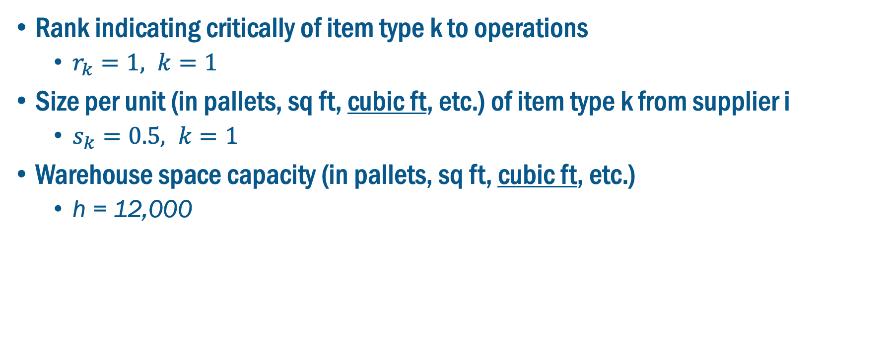
Input Data: Item Type
Rank indicating critically of item type k to operations
$r_{k}=1, k=1$
Size per unit (in pallets, sq ft, cubic ft, etc.) of item type k from supplier i
$s_{k}=0.5, k=1$
Warehouse space capacity (in pallets, sq ft, cubic ft, etc.)
h = 12,000

Slide 9
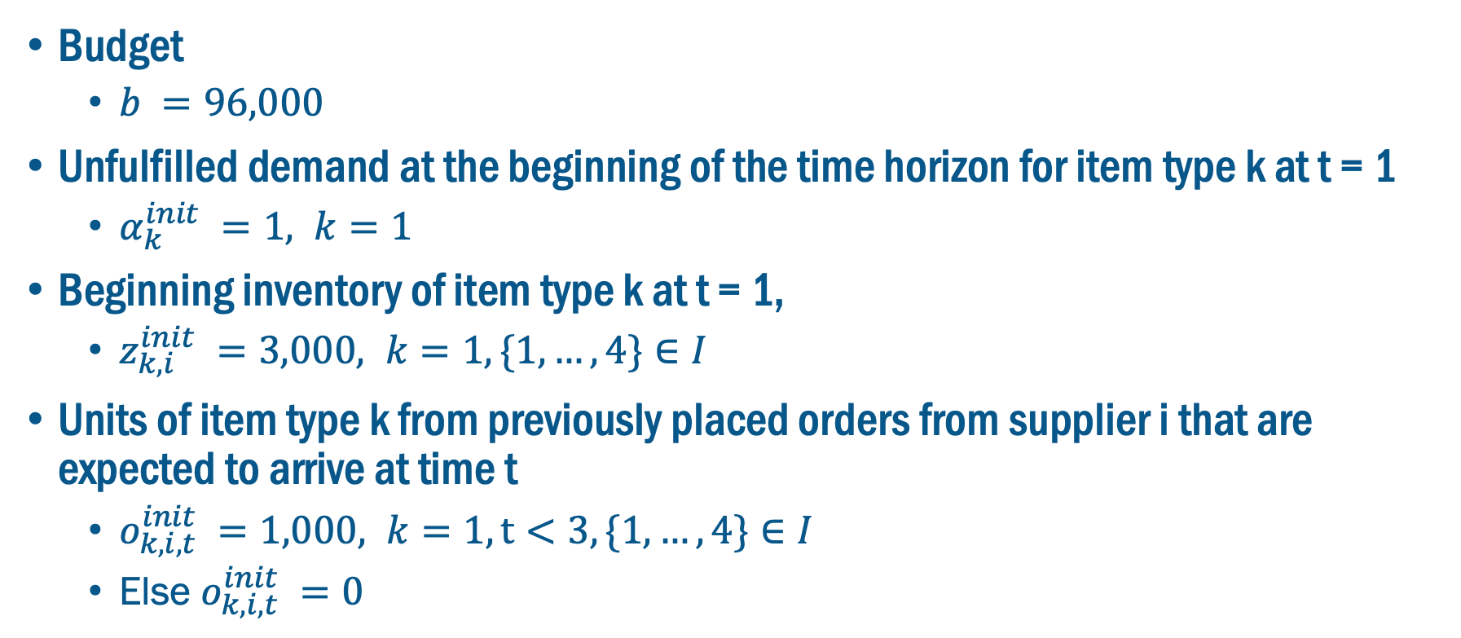
Input Data: Initialization Parameters
Budget
$b =96,000$
Unfulfilled demand at the beginning of the time horizon for item type k at t = 1
$α_{k}^{init} =1, k=1$
Beginning inventory of item type k at t = 1,
$z_{k,i}^{init} =3,000, k=1, \{1, …,4\}∈I$
Units of item type k from previously placed orders from supplier i that are expected to arrive at time t
$o_{k,i,t}^{init} =1,000, k=1, t<3, \{1, …,4\}∈I$
Else $o_{k,i,t}^{init} =0$

Slide 10
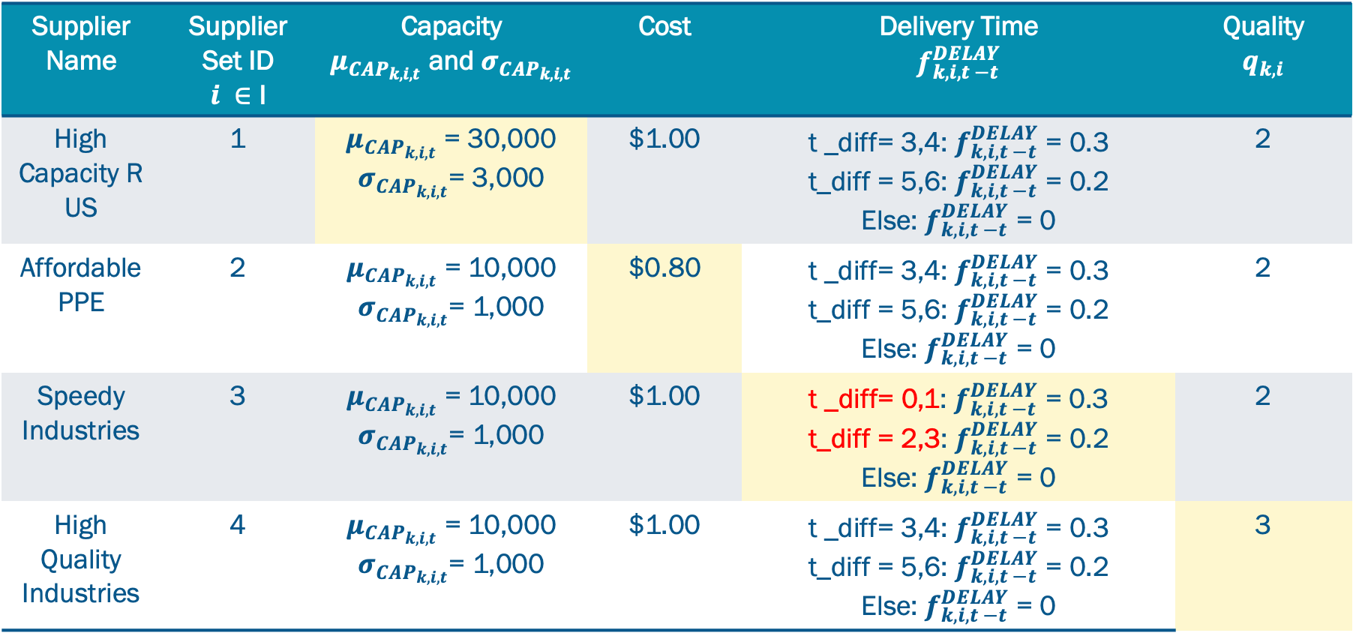
Input Data: Supplier Attributes
Supplier Name | Supplier Set ID $i ∈$ I | Capacity $μ_{{CAP}_{k,i,t}}$ and $σ_{{CAP}_{k,i,t}}$ | Cost | Delivery Time $$f_{k,i, t −t}^{DELAY}$$ | Quality $$q_{k,i}$$
High Capacity R US | 1 | $μ_{{CAP}_{k,i,t}}$ = 30,000 $σ_{{CAP}_{k,i,t}}$= 3,000 | $1.00 | t _diff= 3,4: $f_{k,i, t −t}^{DELAY}$ = 0.3 t_diff = 5,6: $f_{k,i, t −t}^{DELAY}$ = 0.2 Else: $f_{k,i, t −t}^{DELAY}$ = 0 | 2
Affordable PPE | 2 | $μ_{{CAP}_{k,i,t}}$ = 10,000 $σ_{{CAP}_{k,i,t}}$= 1,000 | $0.80 | t _diff= 3,4: $f_{k,i, t −t}^{DELAY}$ = 0.3 t_diff = 5,6: $f_{k,i, t −t}^{DELAY}$ = 0.2 Else: $f_{k,i, t −t}^{DELAY}$ = 0 | 2
Speedy Industries | 3 | $μ_{{CAP}_{k,i,t}}$ = 10,000 $σ_{{CAP}_{k,i,t}}$= 1,000 | $1.00 | t _diff= 0,1: $f_{k,i, t −t}^{DELAY}$ = 0.3 t_diff = 2,3: $f_{k,i, t −t}^{DELAY}$ = 0.2 Else: $f_{k,i, t −t}^{DELAY}$ = 0 | 2
High Quality Industries | 4 | $μ_{{CAP}_{k,i,t}}$ = 10,000 $σ_{{CAP}_{k,i,t}}$= 1,000 | $1.00 | t _diff= 3,4: $f_{k,i, t −t}^{DELAY}$ = 0.3 t_diff = 5,6: $f_{k,i, t −t}^{DELAY}$ = 0.2 Else: $f_{k,i, t −t}^{DELAY}$ = 0 | 3

Slide 11
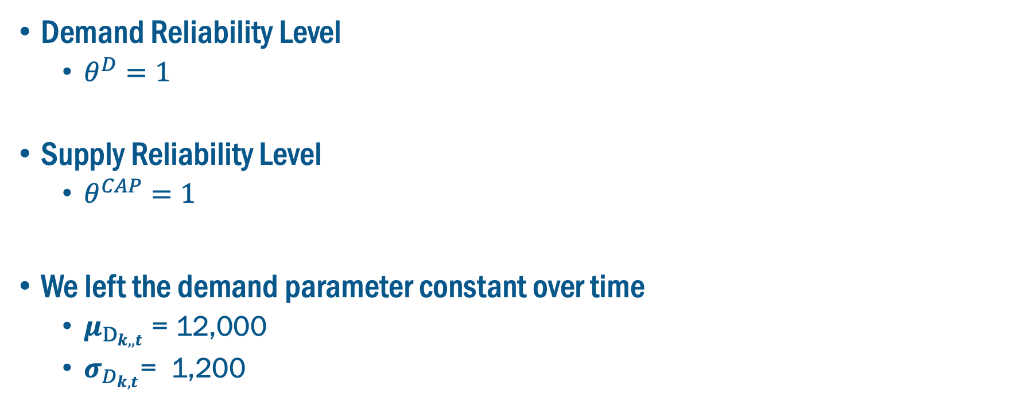
Input Data: Demand and Reliability Levels
Demand Reliability Level
$θ^{D}=1$
Supply Reliability Level
$θ^{CAP}=1$
We left the demand parameter constant over time
$μ_{D_{k,,t}}$ = 12,000
$σ_{D_{k,t}}$= 1,200

Slide 12
Model Outputs

Slide 13
Model Outputs: Ordering and Receiving Schedule
Past Order
Past Order
Past Order
Past Order
Past Order
Past Order
Past Order
Past Order

Slide 14
Model Outputs: Ordering and Receiving Schedule
Past Order
Past Order
1000
1000
1,336
1,336
891
891
8,100
8,100
5,400
5,400

Slide 15
Model Outputs: Ordering Schedule Table
item type | supplier | time interval | units to order | expected units received
1 | 1 | 1 | 27000 | 1000
1 | 2 | 1 | 9000 | 1000
1 | 3 | 1 | 9000 | 1000
1 | 4 | 1 | 9000 | 1000
1 | 1 | 2 | 4453 | 1000
1 | 2 | 2 | 9000 | 1000
1 | 3 | 2 | 9000 | 3700
1 | 4 | 2 | 9000 | 1000
… | … | … | … | …

Slide 16
Model Outputs

Slide 17
Model Outputs

Slide 18
Sensitivity Analysis

Slide 19
Sensitivity Analysis Design: Model Input Variations
We tested the sensitivity of the model outputs to changes in:
Supplier Reliability Levels
Demand Reliability Levels
Budget
Technical Approach
Run all combinations of supplier and demand reliability levels (0,1,2) for a total of 9 combinations
For each combination of supplier and demand reliability level we test different “budget levels” by modifying the budget constraint, changing the parameter b until the budget is no longer a constrained

Slide 20
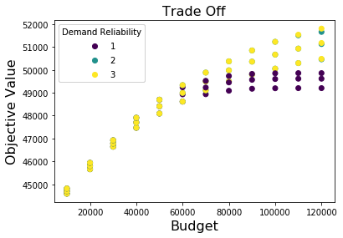
Model Output: Sensitivity Analysis

Slide 21
Next Steps by September 15th
Incorporate feedback into graphs
Complete First-Mile and HHL Presentations
Generate Seattle Case Study*
Primary focus next two weeks
Provide Code to Restart Partners

Slide 23
Model Outputs: Ordering and Receiving Schedule
Past Order
Past Order
1000
1000
8,100
8,100
5,400
5,400

Slide 24
Model Outputs: Ordering and Receiving Schedule
Past Order
Past Order
1000
1000
1,336
1,336
891
891

Slide 25
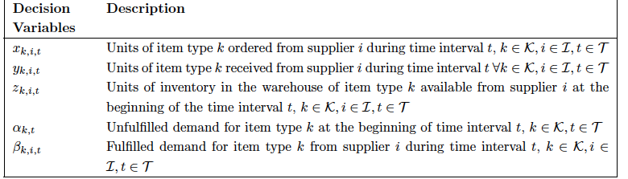

Slide 26
